Slide 1

House Price Prediction
Welcome to the magnum opus of prediction avenue

Slide 2
MACHINE LEARNING BASED HOUSE PRICE PREDICTION
College Name :-VishwaKARMA GOVERNMENT ENGINEERING COLLEGE
Team id sgh000045

Slide 3
STEP 1:-Selecting and Cleaning Data Set
First we selected the suited dataset which serves our feature based prediction of house estimated price
After that following the life cycle of any data science project we proceed ahead by applying concepts of feature engineering
For example removing the features which have most of its value NULL and filling the median value of particular column in place of NULL values

Slide 4
STEP 2:- Selecting the best suited algorithm
After the data cleaning step the dataset it ready to fit(Train) in the model. There are several algorithms available for this type of regression problem like Linear regression, Stackcv regressor and ensemble techniques like Xgboost and Randomforest.Since the Xgboost is the most powerful
Xgboost use basic principle of Decision Tree as boosting method which contain several bags. Suppose first bag contain random training sample then by evaluating with test set if we get wrong predictions then next bag is filled with these wrong predicted samples and further random data samples and these repetitive process goes on
Light GBM : This technique is also give higher accuracy like xgboost and sometimes better than Xgboost. The difference between Light GBM and Xgboost is that Light GBM Splits tree leaf-wise while Xgboost splits tree level wise

Slide 5
STEP 3:-Applying hyperparameter tuning and ANN
In order to gain more rise in our accuracy we deal with the technique of hyperparameter tuning in which we change the predefined parameter of particular algorithm and learned its behaviour
Also we applied deep learning concepts like Artificial Neural Network (ANN) which works better on our 84 feature dataset
For example we change the value of parameter named alpha in gradient descent in case of hyper parameter tuning . Understand the similar functioning of neural network like human brain cells
After doing these we achieve the good accuracy of 90% or above. We have submitted same code in Kaggle house price prediction competition in which our rank was 107.

Slide 6
STEP 4 :-Making web application using flask framework of python
After achieving good accuracy there is a need for a good GUI because most of the todays worlds project are judged by the user regarding its User experience
So we selected the flask framework in order to deploy our machine learning concepts in the form of website which will give an over edge to our project
Using this we will tell the user to enter its designated feature to predict the feature based house price
Basically its includes features like area of house , availability of amenities , square feet area of house

Slide 7
STEP 5 :- Creating chatbot to make our application responsive
If the user doesn’t know much about our website and wants to access the content of our website than we have provided the feature of chatbot through which the user interface will be responsive, interactive, dynamic in nature.
The chatbot is created using the basic concepts of Natural language Processing (NLP) through which above stated thesis is addressed
For example if the user wants to know the highest house price in our data then he has to only type this in to the chatbot then he will get the stipulated result

Slide 8
STEP 6:- For further enhancing the user experience we used maps
By analysing our data we observed that the attributes of a particular region matters a lot in deciding the house price
So we apply the API of maps and by using pushpins and direct the user to the webpage of any particular area selected by user
The graphical trend is provided to the user by these maps feature which in case return the thought of the website to be the user centric

Slide 9
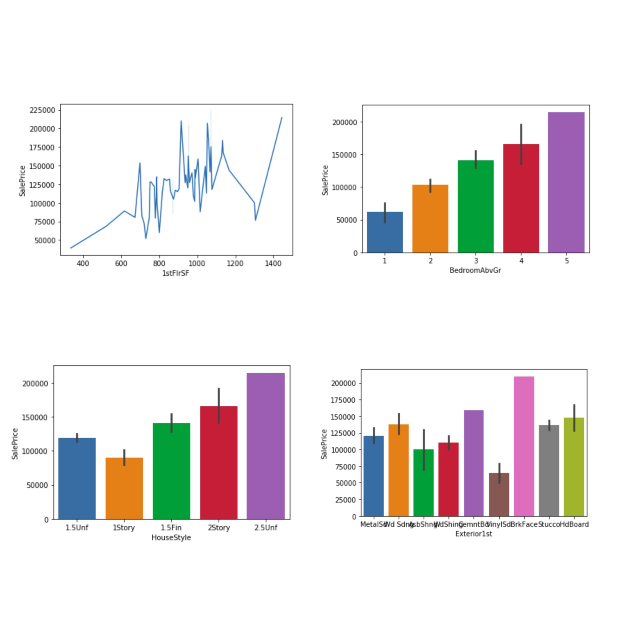
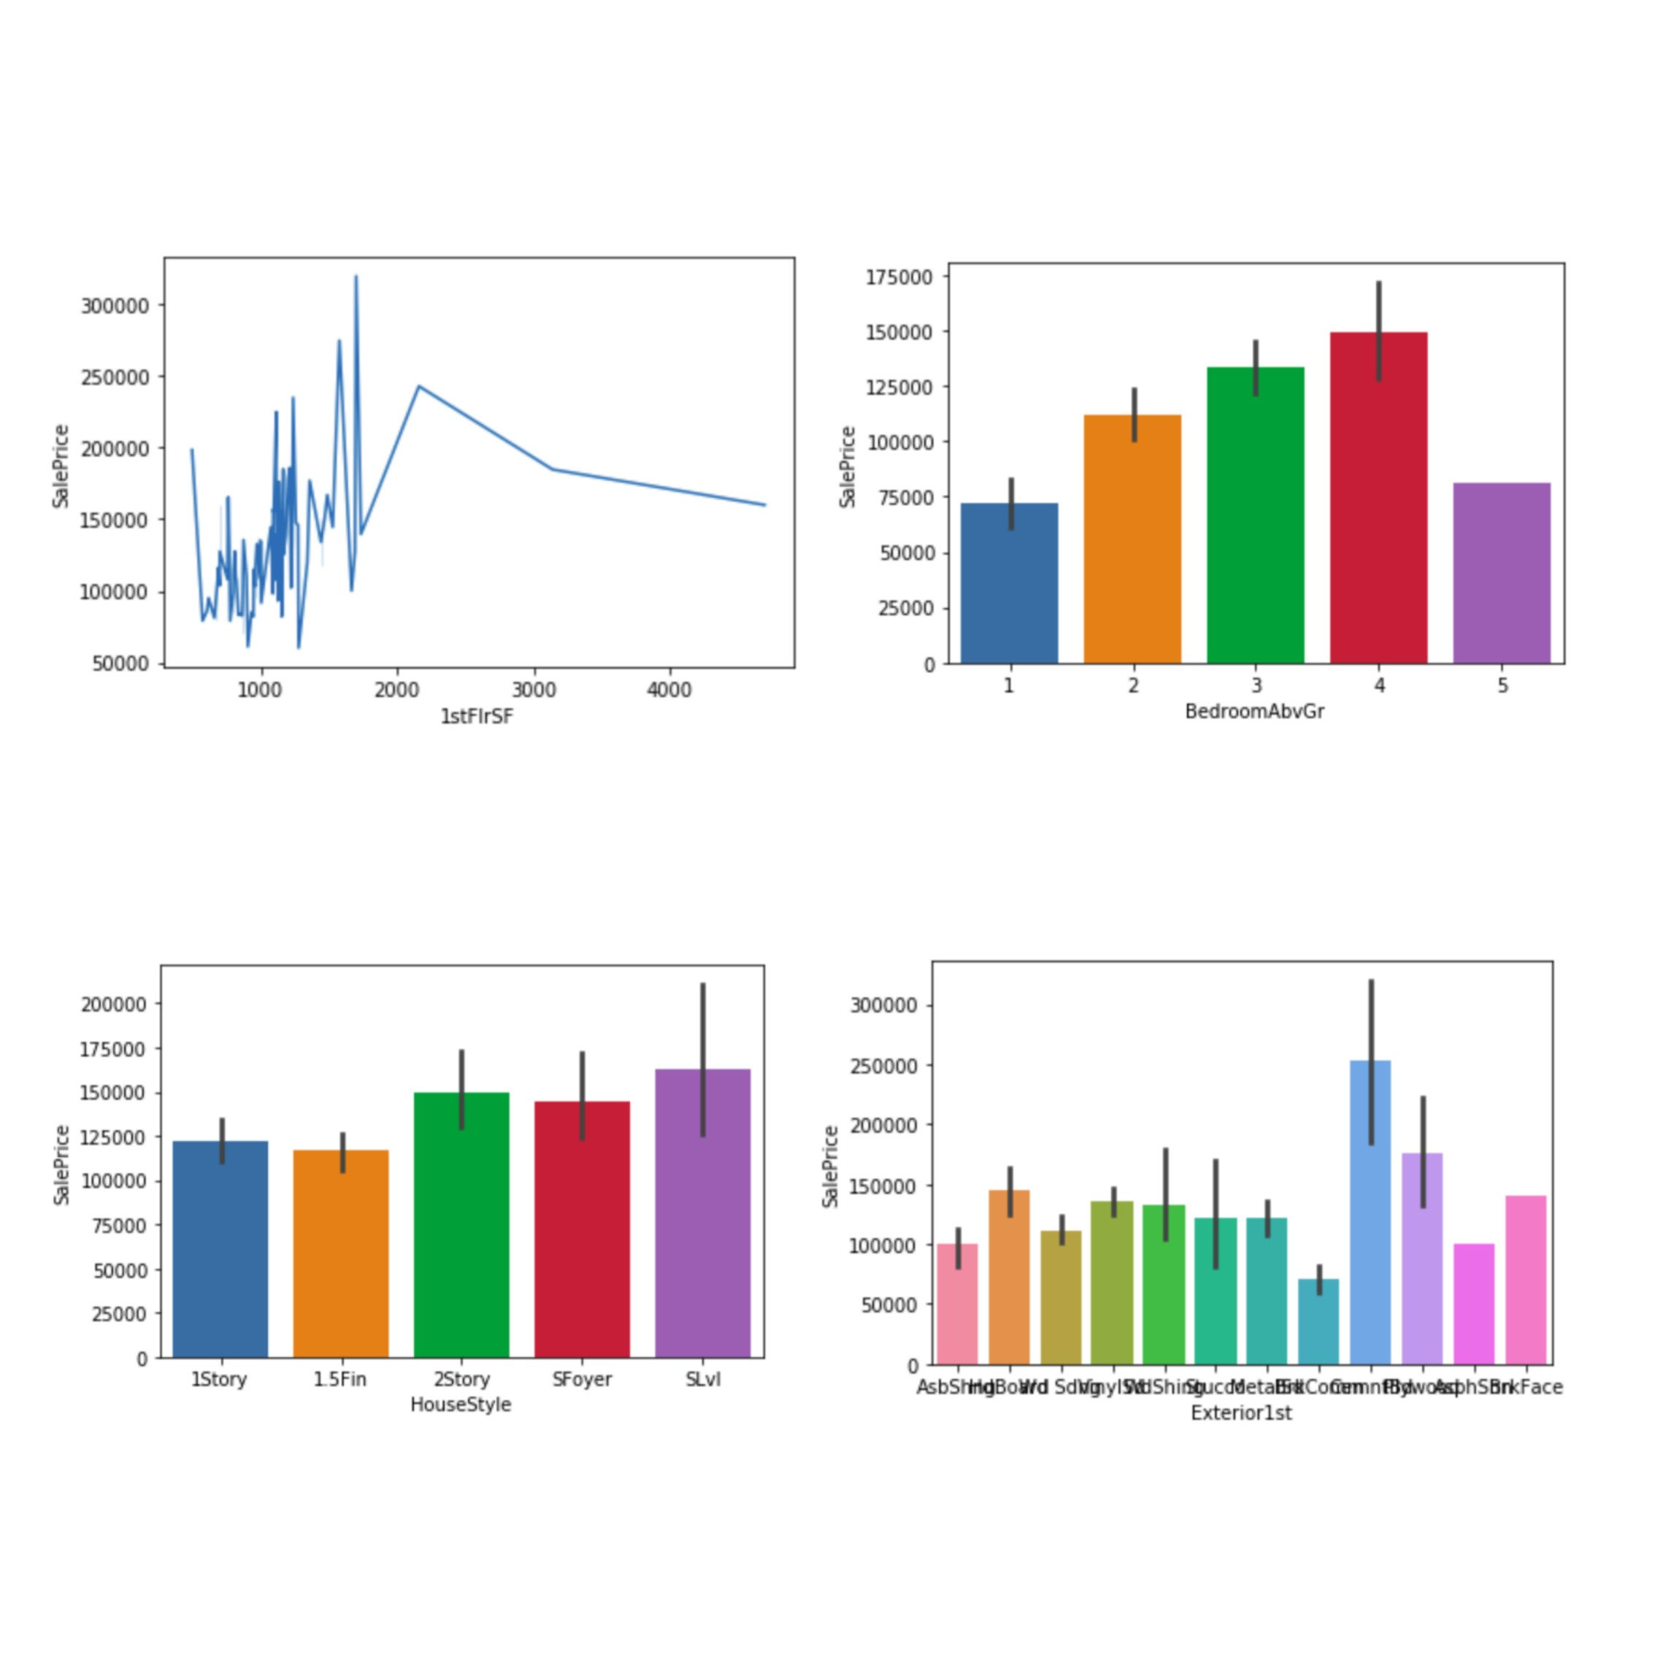
Observations

Slide 10
Observation Description
The above two figures shows the graphical trends of our data by which we can take many important decision regarding our feature based prediction
By these observation we can understand in a better way about the data and which leads to the better accuracy

Slide 11
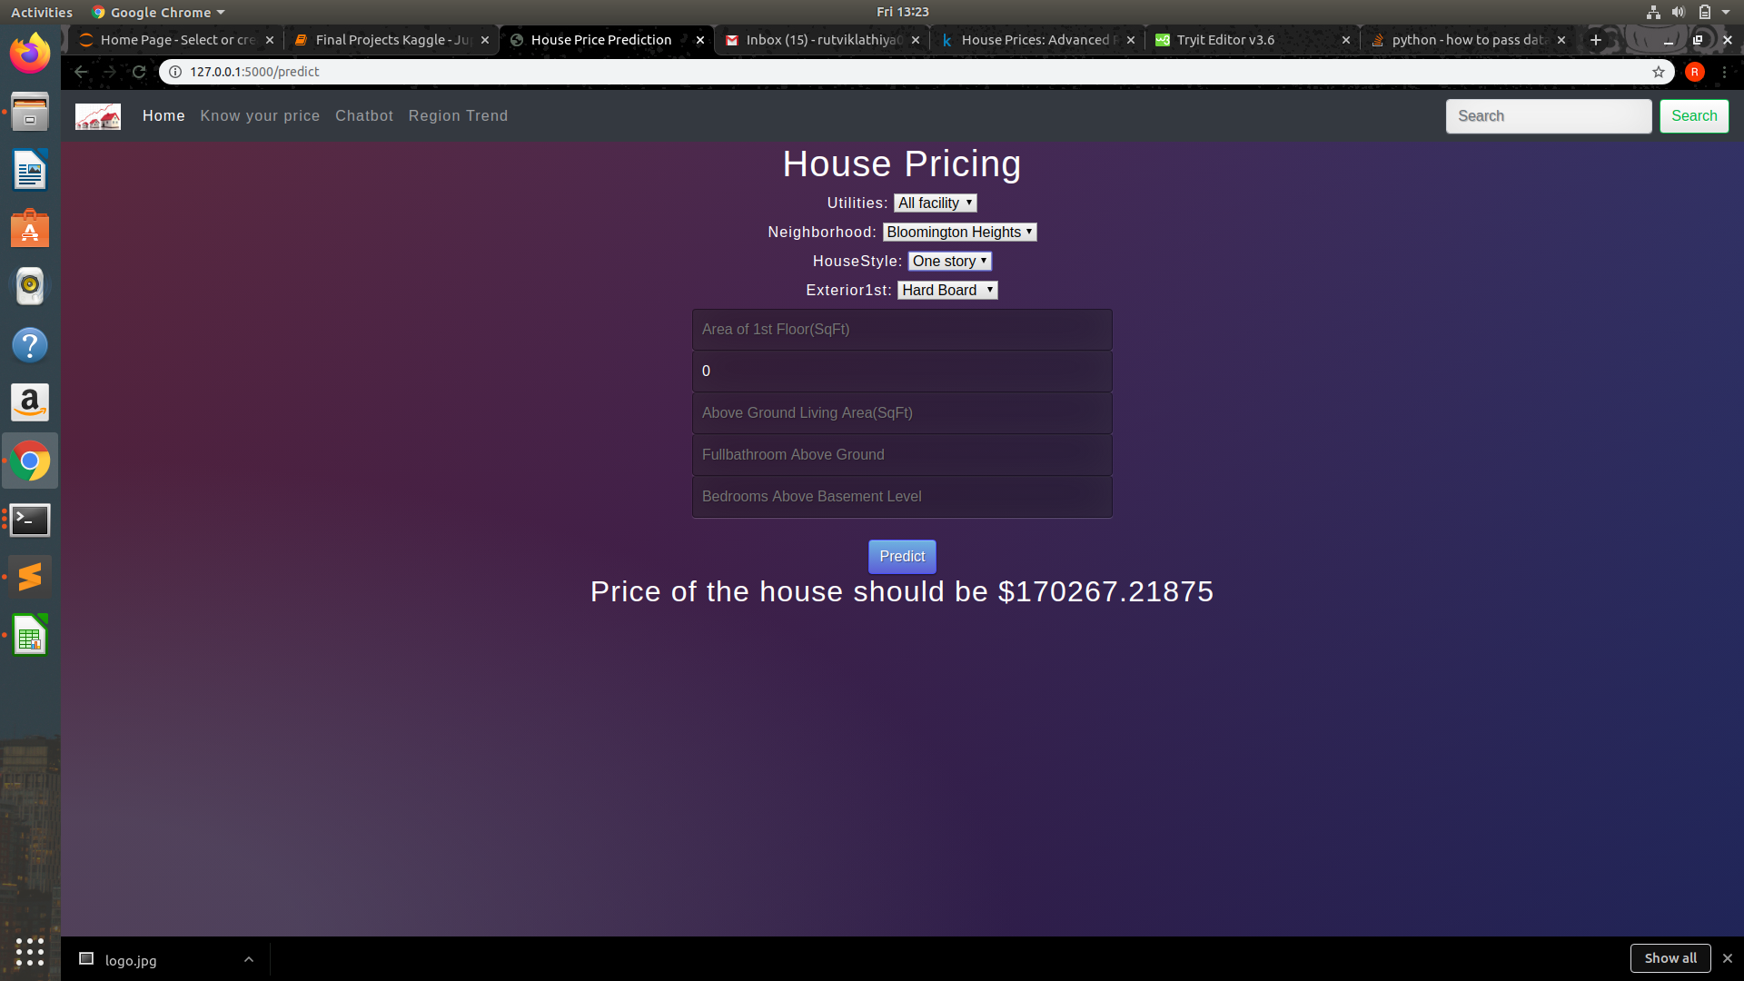
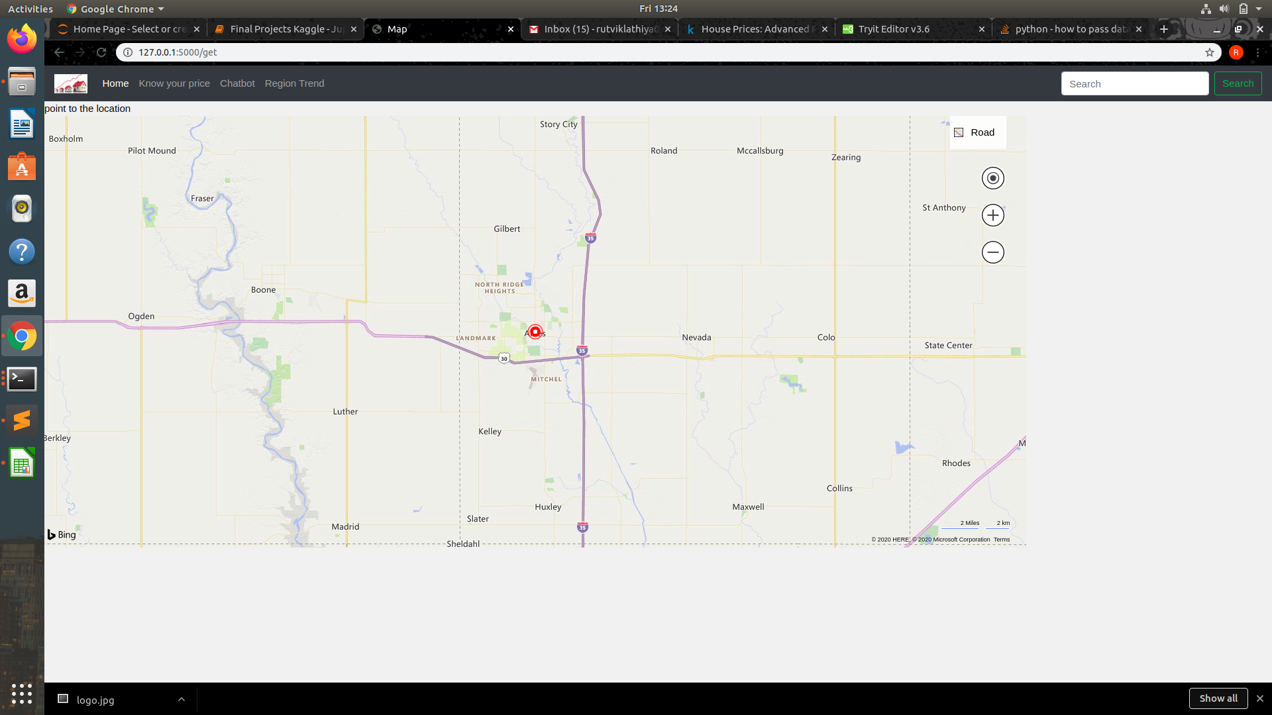
Output

Slide 12
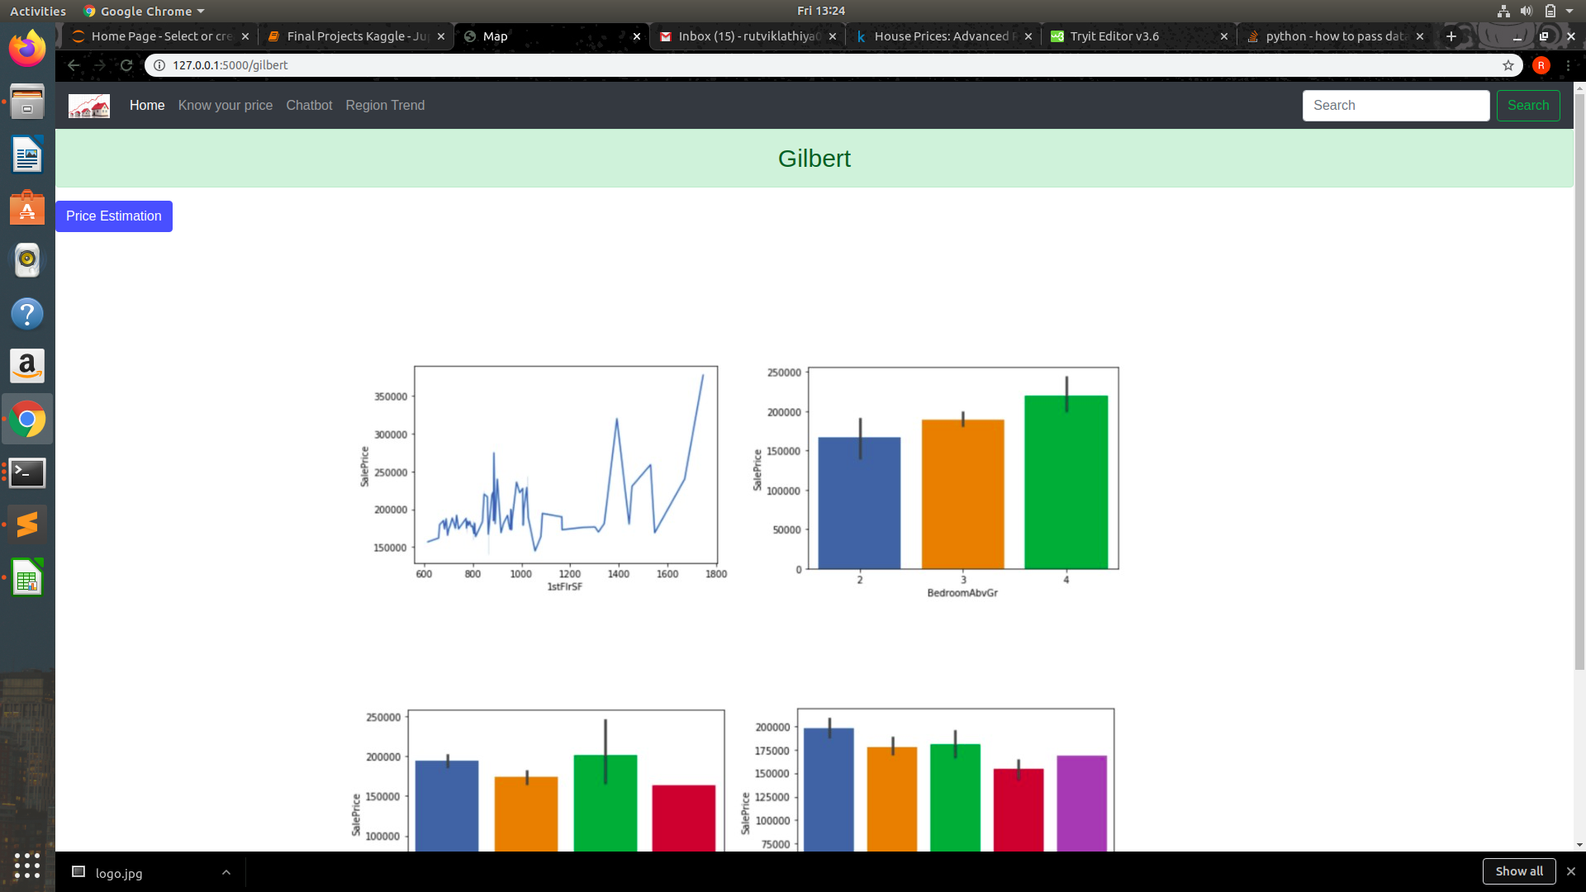
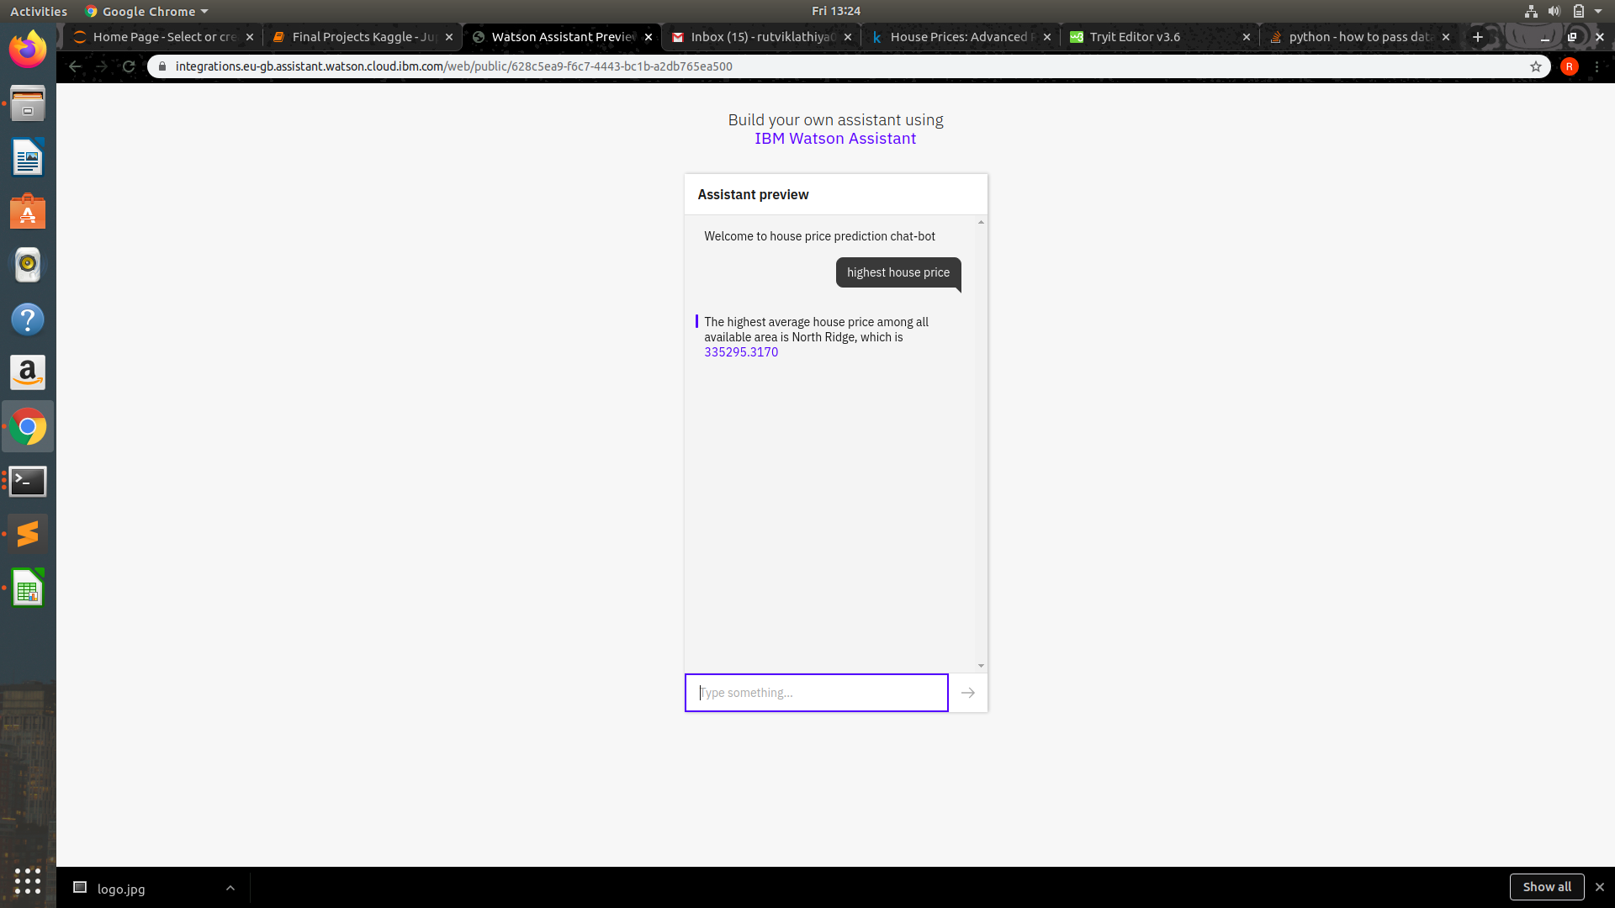
OUTPUT contd

Slide 13
Output Description
The above stated four images states the four web page of our website by these the output of our website can be understand.

Slide 14
Conclusion
Summarising the whole project firstly we done the backend part which was enriched by the concept of the machine learning and then focus on the front end part
Back end :- It includes the process like data cleaning , feature engineering, model building and many others. Mainly during these steps the accuracy of our model was defined
Front end :- It includes the various segment of our website like HTML form to fill the feature, chatbot ,maps , home etc
Hence here we concluded the description of our project.

